Slide 1
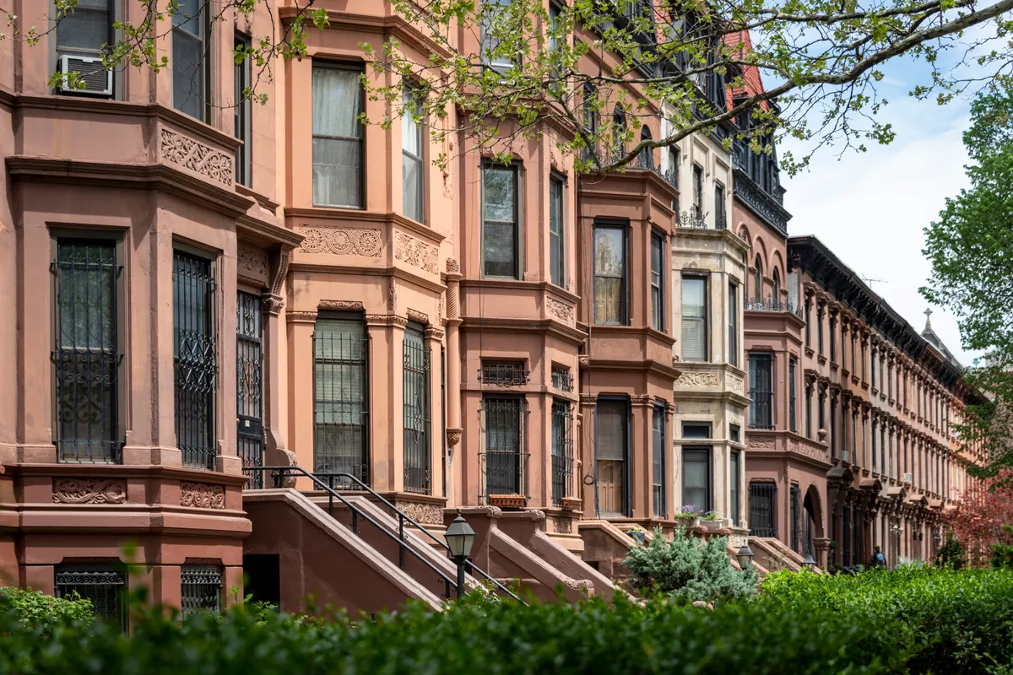
Baltimore’s Broken Brownstones
How vacant buildings affect student outcomes
By: Johnny Saldana & Dabeluchukwo Emegoakor

Slide 2
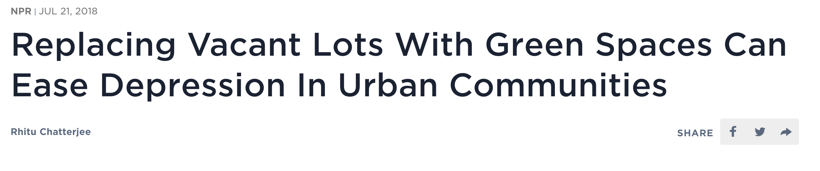
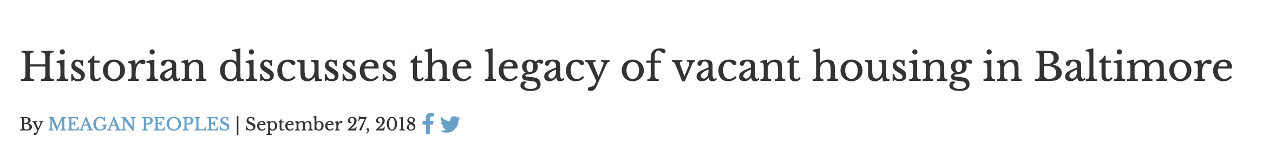
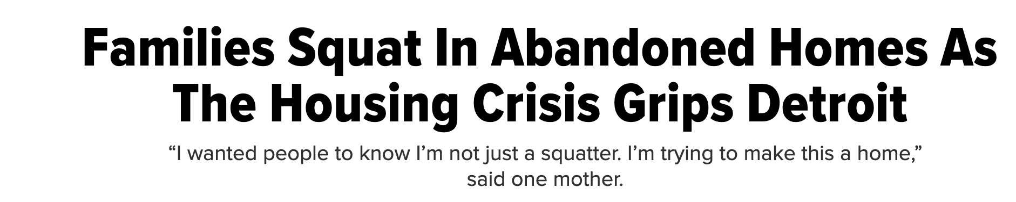
Background
Notes:
https://github.com/jhu-business-analytics/Midterm-Johnny-Dab/edit/master/README.md

Slide 3
Business Questions
Do vacant buildings near schools lower attendance?
Who are we presenting to?
What’s our time frame?

Slide 4



Data Questions
What have other people done?
Wealth & student outcomes
Housing & student outcomes
Baltimore vacant housing data
Maryland school accountability data
What datasets should we use?
What tools could be helpful?
Python (pandas, sci-kit learn, numpy)
Excel
Business Analytics 2019

Slide 5
Analysis Process
Interpret Results
3
Run Analysis
2
Find & Clean Data
1
Business Analytics 2019

Slide 6
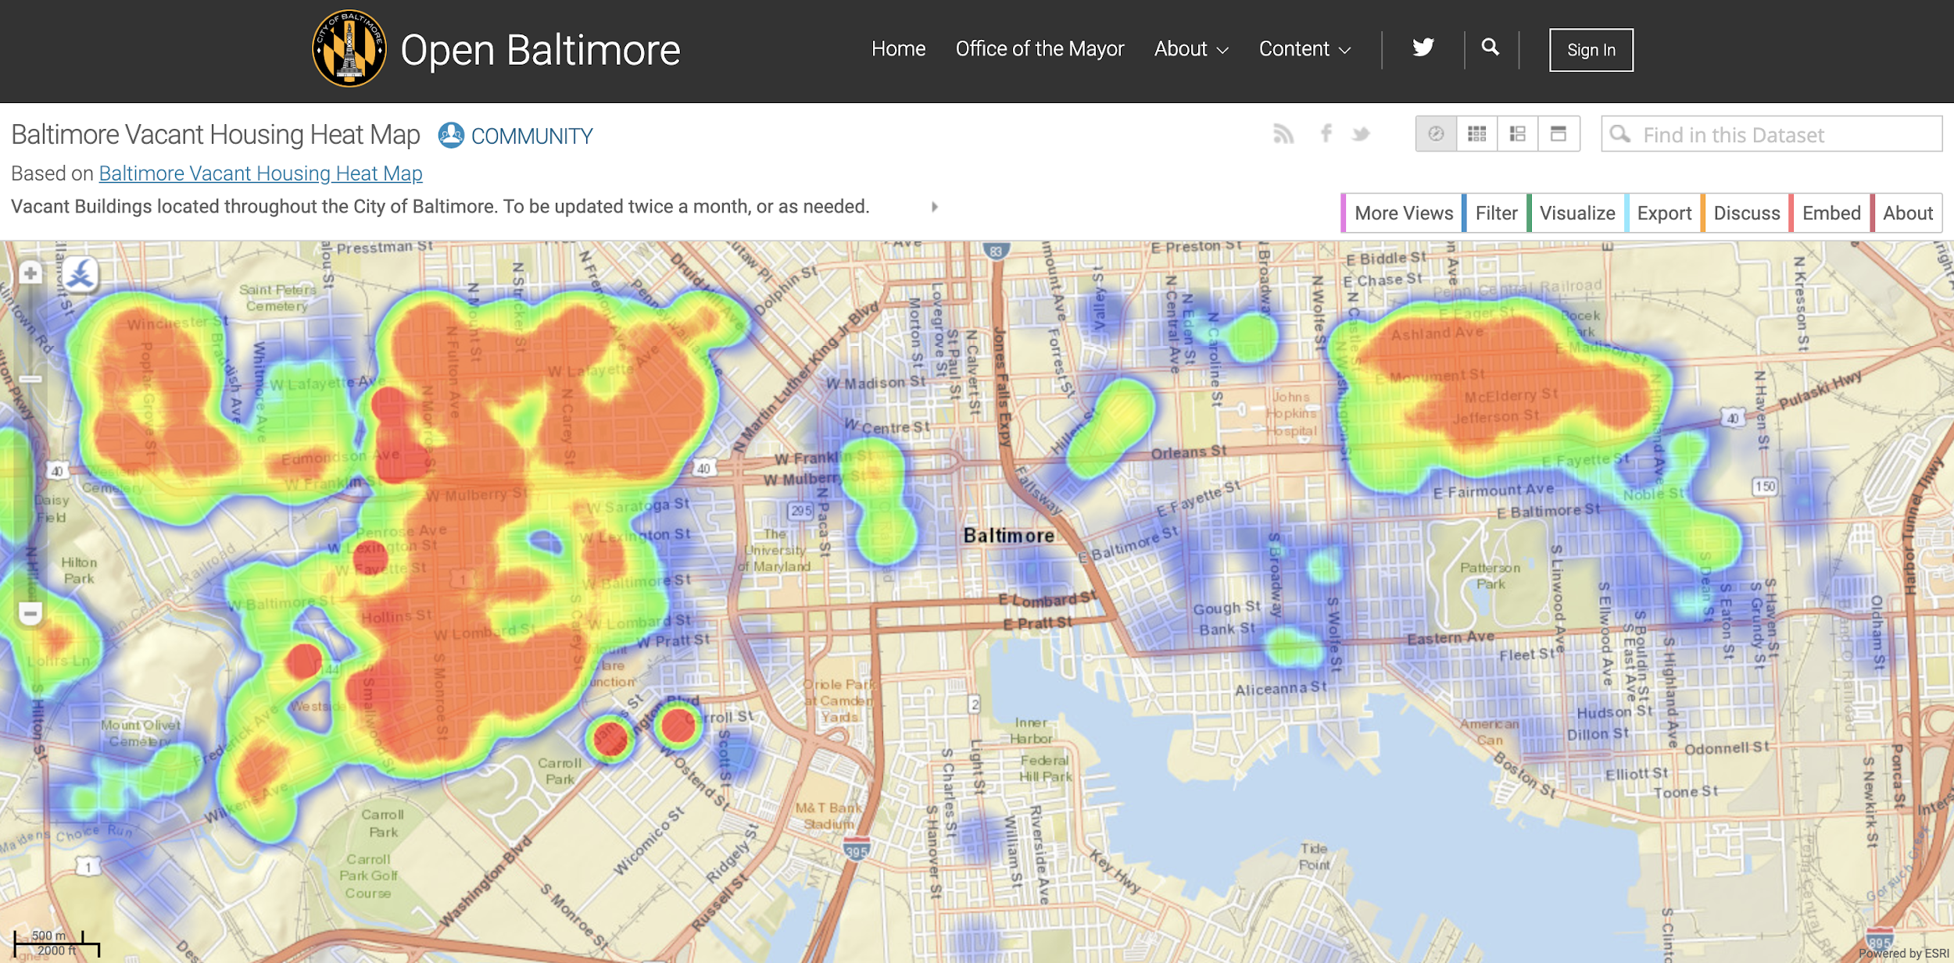
Find Data
Business Analytics 2019

Slide 7
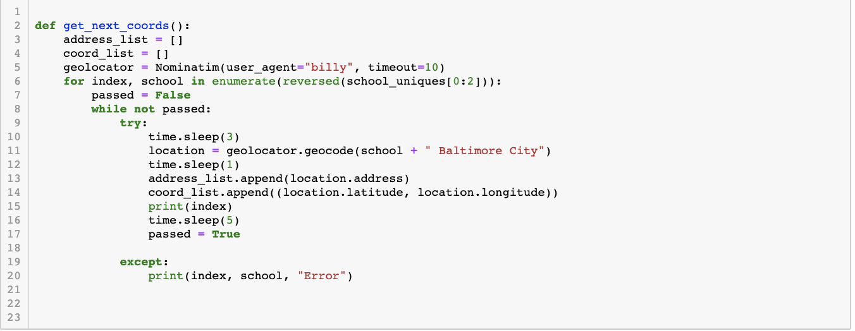
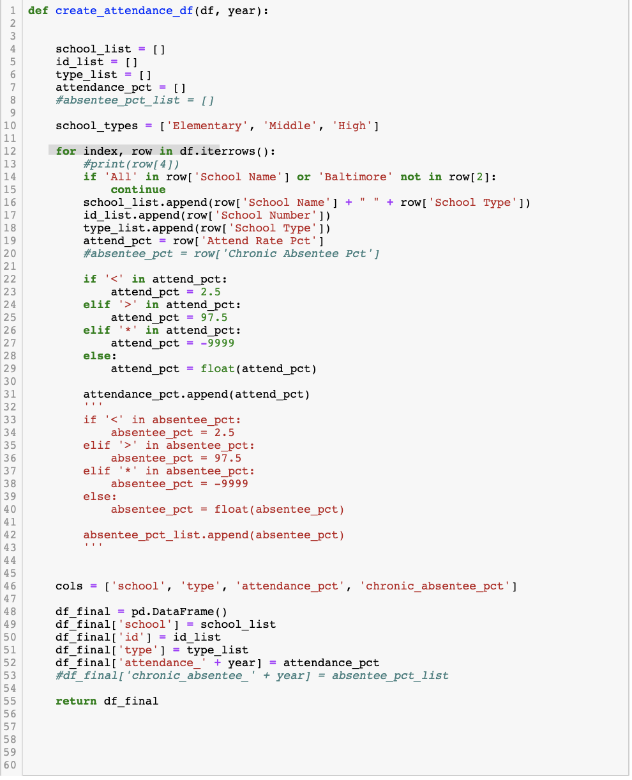
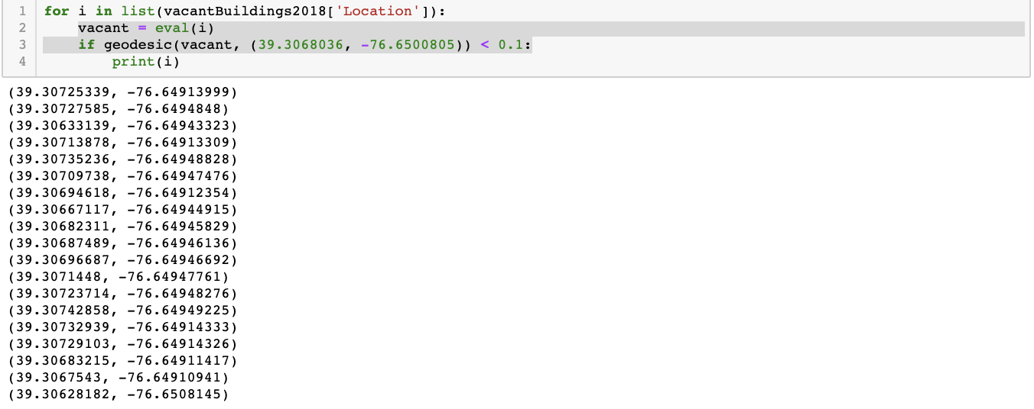
Clean Data
Geolocate schools based on addresses
Create year by year attendance data
Find number of vacant buildings within 0.1 miles of schools
Business Analytics 2019

Slide 8
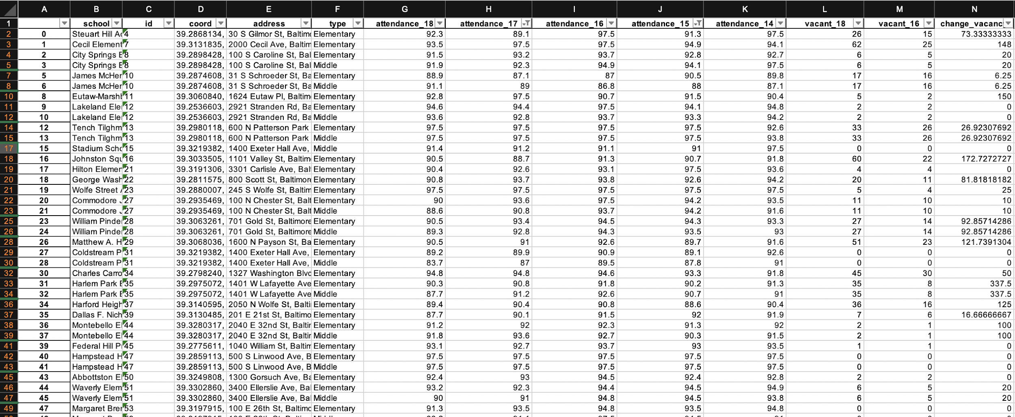
Final Data Set
Business Analytics 2019

Slide 9
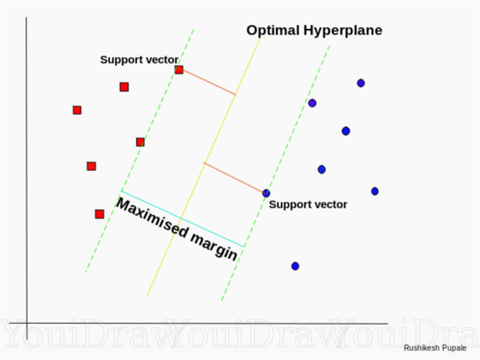
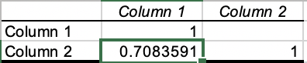
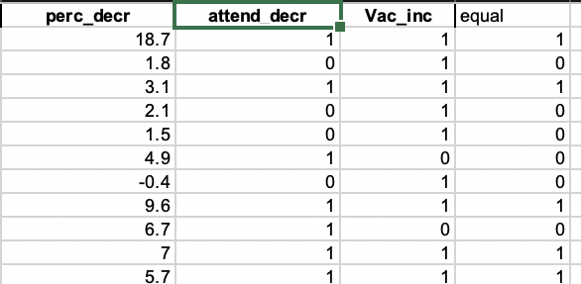
Complex Analysis
SVM Regression Model
Excel correlation & Regression
Business Analytics 2019

Slide 10
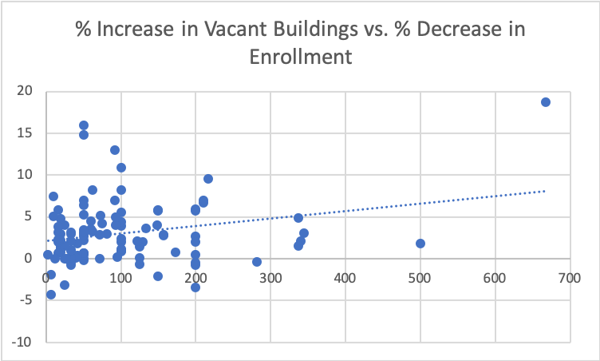
Complex Analysis
Attendance
On average, if vacant housing goes up by 100%, then attendance decreases by 3%
Business Analytics 2019

Slide 11
Key Findings (Data Answers)
On average, there has been a 43% increase in vacancies around schools in Baltimore from 2016 to 2018
On average, there has been a 3% decrease in school attendance in Baltimore from 2016 to 2018
Schools that have the highest increases in vacant buildings, tend to also have the greatest drops in enrollment
Business Analytics 2019

Slide 12
Specific Examples
Augusta Fells Savage Institute of Visual Arts High
Vacant building count increased 660% from 3 to 27
Enrollment dropped 18% from 82% in 2016 to 63% in 2018
Bluford Drew Jemison STEM Academy West High
Vacant building count increased 93% from 26 to 50
Enrollment dropped 13% from 89% in 2016 to 81% in 2018
Business Analytics 2019

Slide 13
Business Answers
Based on the data answers
There seems to be an association between increased vacancies and decreased attendance
Further research could demonstrate that there is a psychological effect on children when they see abandoned buildings near their schools

Slide 14
What should we do?
There is evidence that suggests the environment a student goes to school in affects their attendance. Therefore, The Baltimore City Government should prioritize the destruction of vacant buildings near schools districts to help curb attendance attrition

Slide 15

Questions

